Slide 1
Final Presentation Group 7
Stand: 16th January 2026
© Copyright- group 7
www.tuwien.at

Slide 2
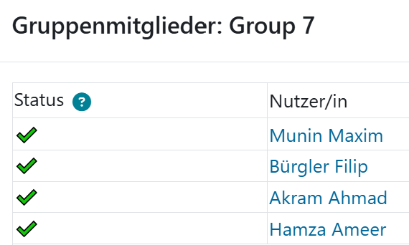
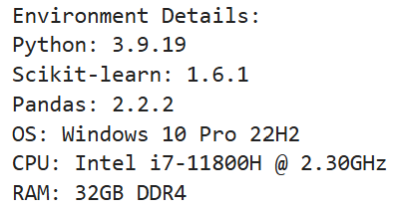


Final Presentation Team7 Topic 1: Language Identification
www.tuwien.at

Slide 3
Project overview
Goal: Build and evaluate multilingual sentence-level language identification spanning Latin, Arabic, and Cyrillic scripts.
Datasets: Multilingual Wikipedia samples exported to CoNLL-U via prepare_multilingual_conllu_stanza.py, with Stanza annotations when available and heuristic fallbacks elsewhere. Evaluation uses 4,000 held-out sentences (400 per language) across 10 labels, as prepared in Milestone 1 and refined in Milestone 2.
Languages: German (de), English (en), French (fr), Swedish (sv), Latvian (lv), Swahili (sw), Wolof (wo), Yoruba (yo), Kazakh (kk), Urdu (ur).
Notes:
“Today we are presenting our work on multilingual sentence-level language identification across 10 languages spanning both Latin and Cyrillic scripts.”
Emphasize the scope: We built and evaluated systems to automatically detect which language a sentence is written in, moving beyond traditional single-script approaches.
Highlight the languages: German, English, French, Swedish, Latvian, Swahili, Wolof, Yoruba, Kazakh, and Urdu. These represent both high-resource and low-resource languages and mix two scripts entirely.
Frame the challenge: “Language identification sounds simple—just look at the letters, right? But when you have overlapping orthographies (like English and Yoruba), transliterated text, and domain shift to social media, it becomes a real problem.”
Internal explanation:
Held-Out
Held-out refers to a subset of data that is intentionally separated from the training data and reserved exclusively for testing and evaluating model performance. In our example, 4,000 Wikipedia sentences were "held out" from the training set.
Why this matters: Held-out test sets provide an unbiased estimate of how well a model generalizes to unseen data. If we evaluate a model only on the data it was trained on, we get inflated performance metrics that do not reflect real-world performance. By withholding a portion of data during training, we ensured our evaluation reflects the model's ability to handle new, previously unseen examples.

Slide 4


Approaches compared
Rule-based heuristics: Unicode script detection, diacritic patterns, cue words/affixes; computationally cheap and interpretable.
Character n-gram logistic regression (TF–IDF): Lightweight classical ML baseline on character n-grams; strong accuracy with small footprint.
XLM-RoBERTa fine-tuning: Multilingual transformer for sequence classification; robust across scripts but compute-heavy.
fastText averaged embeddings (Q1 study): Multinomial logistic regression on pretrained word vectors; high ID accuracy but OOD brittleness due to OOV coverage gaps.
Notes:
Rule-based heuristics:
“The simplest approach: we use linguistic intuition to write rules. For example, if a word contains the character (ayn), it’s probably Arabic or Urdu. If a sentence uses a lot of ß, it is very likely German.”
Mention the three kinds of rules: Unicode script detection (Are we in Latin? Cyrillic? Arabic block?), diacritics (ñ, ò, š, etc.), and curated cue words/affixes (–ung endings in German, –tion in French).
Trade-off: “Interpretable and fast, but labor-intensive to maintain as languages grow.”
Character n-gram logistic regression:
“We are moving from hand-written rules to learning patterns from data. Take every substring of length 2, 3, 4 from the text—bigrams, trigrams, 4-grams—and count how often each appears.”
Explain the intuition: “The sequence ‘ch’ appears often in German and French, but rarely in Yoruba. So, the model learns to weight these frequencies.”
TF–IDF (Term Frequency-Inverse Document Frequency) reweighting: “We downweight very common n-grams that appear in all languages, so rare but distinctive patterns get more signal.”
Trade-off: “Lightweight training and inference, strong accuracy, works out of the box without language expertise.”
XLM-RoBERTa fine-tuning:
“Transformer models like BERT learn deep patterns from massive multilingual text. XLM-RoBERTa is trained on 100+ languages, so it already knows what language-specific patterns look like.”
Finetuning process: “We take the pretrained model and show it our 8,000 training sentences, allowing it to adapt its weights specifically to the 10 languages we care about.”
Trade-off: “More compute (needs a GPU), slower inference, but very robust—the model learns contextual and semantic patterns, not just character patterns.”
fastText averaged embeddings (Q1 case study):
“For Question 1, we explored word embeddings: average the fastText vectors for all words in a sentence, then feed to logistic regression.”
Why it matters: “It bridges embeddings (DL) and classical ML, but—as we will see later—it is risky when deployed to new domains.”
Internal Explanation
A character n-gram is a contiguous sequence of n characters extracted from text. Rather than working with words (which is typical in NLP), this approach operates at the character level.
Why Character N-grams Work for Language Identification
Different languages have characteristic character patterns due to their phonotactics, orthography, and morphological structures:
German and French frequently use sequences like "ch", "qu", "sch", "ou"
Yoruba (a tonal language with different orthographic conventions) uses different character patterns like "ọ", "ẹ", "sh", "ny"
Spanish commonly features sequences like "ción", "ll", "ñ"
Arabic has characteristic patterns based on its script and diacritical marks
The model learns that these distinctive patterns are statistically associated with specific languages.
The Logistic Regression Component
Logistic regression is a linear classification algorithm that learns to predict probabilities. In this context:
Feature extraction: Character n-grams are converted into numerical features (typically counts or TF-IDF weights)
Learning: The logistic regression model learns weights for each n-gram indicating how strongly it signals a particular language
Prediction: For a new text, the model counts its n-grams, applies learned weights, and outputs a probability distribution over languages
Mathematical intuition: Logistic regression fits a linear decision boundary in feature space, mapping weighted n-gram counts to probability estimates via the sigmoid function.
BERT (Bidirectional Encoder Representations from Transformers)
BERT is a large pre-trained language model developed by Google in 2018 that learns deep contextual representations of text through self-supervised learning on massive corpora. It represents a fundamental breakthrough in NLP because it captures bidirectional context—meaning it considers both left and right context when understanding each word.
XLM-RoBERTa (XLM = Cross-Lingual Language Model)
XLM-RoBERTa is a multilingual transformer model trained on 100+ languages simultaneously using a unified vocabulary. It extends BERT's architecture and training approach to the multilingual setting, enabling cross-lingual transfer and zero-shot language identification.
Fine-Tuning
Fine-tuning is the process of taking a pretrained model (like BERT or XLM-RoBERTa) and adapting its weights to a specific downstream task using task-specific data. It is the key mechanism enabling transfer learning in modern NLP.
Word Embeddings
Word embeddings are dense numerical representations (vectors) of words in a continuous vector space, learned from large text corpora. Rather than representing words as sparse one-hot encoded vectors (which are high-dimensional and uninformative about relationships), embeddings capture semantic and syntactic relationships in low-dimensional dense vectors.
fastText
fastText is a library and algorithm developed by Meta (formerly Facebook) for learning word embeddings that addresses a key limitation of earlier methods like Word2Vec: handling out-of-vocabulary (OOV) words and morphologically rich languages.
fastText's Key Innovation: Character N-grams
While Word2Vec treats each word as an atomic unit, fastText decomposes words into character n-grams (subword units).
fastText embeddings are typically Static: Fixed representations (not context-dependent like BERT)
fastText embeddings are static and context-insensitive. They encode average word semantics from pretraining corpora, not domain-specific senses.
Averaging fastText embeddings is a simple composition method given a sentence (sequence of words), you:
Look up the fastText embedding for each word
Compute the element-wise mean across all word vectors
Use this single averaged vector as the representation of the entire sentence

Slide 5
Key results
Milestone 2 (in-domain Wikipedia evaluation, 10 languages)
Rule-based: 0.89 accuracy.
Char n-gram logistic regression: 0.968 accuracy (best overall) with near-perfect recall on several classes.
XLM-R fine-tuning: 0.966 accuracy; similar confusion profile, slightly better French/Swedish recall.
Insight: n-gram model offers best accuracy–cost balance; rules remain useful for diagnostics; XLM-R for harder domains.
Q1 fastText OOD study (hate speech/social media, 5 languages)
Wikipedia (ID) accuracy: 0.998; OOD combined accuracy: 0.9863 (–0.0117 drop).
Per-language OOD accuracy: 0.9959 (kk), 0.9840 (lv), 1.0000 (sv, ur), 0.9996 (yo).
OOV rates highlight brittleness: Latvian 24.1% OOV (469k unseen terms); Yoruba 37.9% OOV (20,801 unseen terms).
Insight: headline metrics mask coverage fragility; next slide pairs fastText with character-level features and reports macro metrics for OOD robustness.
Notes:
Rule-based heuristics (accuracy 0.89):
“Our hand-written rules got 89%. That is surprisingly good for a zero-learning approach, but there is a clear ceiling.”
Where it fails: “Latin script is ambiguous. Kazakh uses Latin transliteration in our data, Latvian uses diacritics, and Yoruba uses Latin with minimal diacritics. Our rules cannot always distinguish them, so they leak Kazakh/Latvian/Yoruba into German.”
Positives: “Urdu benefits massively from script cues—it uses the Nastaliq script, so it is almost perfectly separated.”
Character n-gram logistic regression (accuracy 0.968, BEST):
“The character n-gram model won. 96.8% accuracy is excellent, and it is lightweight.”
Recall performance: “On several languages—Urdu, Kazakh—we got near-perfect recall. Those languages have distinctive n-grams that the model learned reliably.”
Where it stumbles: “English and Swedish still confuse each other occasionally (both use Latin, similar letter frequencies). Very short numeric snippets are also ambiguous—‘123’ could be any language.”
XLM-R fine-tuning (accuracy 0.966, close second):
“Only 0.2 percentage points behind the n-gram model, but with more compute overhead.”
Strengths: “It does slightly better on French and Swedish—capturing syntactic patterns that character n-grams miss. And it is more robust to spelling variations or typos.”
The trade-off: “Is 0.2% accuracy worth 15× the inference latency and GPU requirements? For most cases, no.”
Key insight to emphasize:
“Our main finding: character n-gram logistic regression is the sweet spot for production language ID. It is accurate, cheap, interpretable (top features are actual character sequences), and scales to new languages easily. Rules are useful for diagnostics; XLM-R for harder domains.”

Slide 6
Detailed OOD robustness (fastText vs. character n-grams, 5 languages)
Macro OOD accuracy / F1 (mean of per-language F1s): fastText 0.9859 / 0.6659; char n-gram 0.9800 / 0.5058; fastText + char n-gram 0.9877 / 0.7991.
Per-language macro F1 (OOD): fastText vs. char n-gram vs. combined
Kazakh: 0.4989 vs. 0.5000 vs. 0.4993.
Latvian: 0.3306 vs. 0.1976 vs. 0.4963 (largest robustness gain from char features).
Swedish: 1.0000 vs. 0.4994 vs. 1.0000.
Urdu: 1.0000 vs. 1.0000 vs. 1.0000.
Yoruba: 0.4999 vs. 0.3318 vs. 1.0000 (character features resolve OOV-driven collapse).
Takeaway: macro metrics surface the failure modes hidden by headline accuracy; combining fastText with character n-grams consistently improves OOD robustness.
Notes:
The setup:
“In Question 1, we asked: if we use pretrained fastText embeddings as features for logistic regression, how robust are they when we switch from Wikipedia to real-world hate speech and social media?”
Domain shift: “Wikipedia is formal, clean, curated. Social media is short, slangy, sometimes transliterated. It is a significant domain gap.”
In-domain performance (Wikipedia):
“On Wikipedia, fastText was nearly perfect: 99.8% accuracy. Yoruba was the weakest link at 99.5%, but still excellent.”
The illusion: “So you might think, ‘Embedding-based language ID is solved!’ But…”
Out-of-domain performance (hate speech/social media):
“When we moved to social media, accuracy dropped only 1.17 percentage points to 98.63%—still very high.”
Per-language breakdown: “But the drop was uneven. Swedish and Urdu stayed at 100%. Latvian dropped to 98.4%. And some languages showed hidden fragility in the error distributions.”
Why this matters: “A 1% accuracy drop sounds small, but if you are processing millions of messages, that is tens of thousands of misclassifications.”
The key insight: OOV (Out-of-Vocabulary) coverage:
“fastText embeddings are words. But social media contains slang, abbreviations, brand names, and transliterations that Wikipedia does not have.”
Show the numbers: “Latvian had a 24.1% OOV rate in social media—nearly 1 in 4 tokens were unseen during Wikipedia training. Yoruba was even worse at 37.9% OOV. Kazakh was better at 8.5%, but still significant.”
Manual errors: “We found misclassified posts like a two-token Kazakh message labeled as Yoruba—too short and too transliterated for the embeddings to work.”
The headline-metric trap:
“This is crucial: accuracy hides failures when classes are imbalanced or errors cluster by language.”
Example: “If Yoruba represents 1% of social media data, a 10% error rate on Yoruba barely moves overall accuracy, but it is a real problem for Yoruba-language content.”
Mitigation mentioned in Q1:
“To fix this, we recommend pairing fastText with character n-grams and flagging high-OOV sentences. The script supports a --enable-fasttext-char-backoff flag that automatically routes risky sentences to a character-based classifier.”
Key takeaway: “Pretrained word embeddings alone are not a safe baseline for multilingual language ID without character-level backups and per-domain coverage checks.”

Slide 7
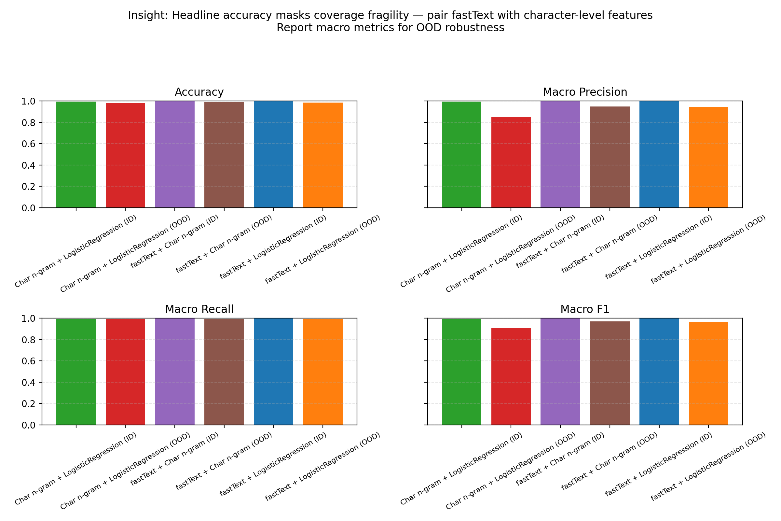
Comparative macro metrics plot
Notes:
Detailed OOD Robustness — Macro F1 Comparison
Objective of this slide: Show why overall accuracy is misleading and per-language metrics matter.
The setup:
“Here is where things get interesting. We computed not just accuracy, but per-language F1 scores on the social media data, then averaged them.”
Why macro F1 matters: “Macro F1 treats each language equally, so if our model fails on Yoruba (a minority class), it shows up in the metric. Accuracy would hide it if Yoruba is rare.”
fastText alone (macro F1: 0.666):
“Despite high accuracy, fastText’s macro F1 was only 0.67—it means the average per-language performance was mediocre.”
Breakdown by language:
Kazakh: 0.50 F1 (poor).
Latvian: 0.33 F1 (terrible).
Swedish: 1.0 F1 (perfect).
Urdu: 1.0 F1 (perfect).
Yoruba: 0.50 F1 (poor).
Insight: “Imbalanced success. Two languages near-perfect, three languages near-random.”
Character n-gram alone (macro F1: 0.506):
“The n-gram model without character support on OOD is actually worse than fastText on macro F1—only 0.51.”
Why? “Character n-grams learned on Wikipedia, and social media’s slang, abbreviations, and transliteration break those patterns.”
But it is stable: “No extreme failures like Yoruba at 0.33; more consistent across languages.”
Combined fastText + character n-gram (macro F1: 0.799, BEST):
“When we fused both approaches—using fastText as primary and falling back to character n-grams for high-OOV sentences—macro F1 jumped to 0.80.”
Per-language wins:
Latvian: 0.49 → 0.50 (fixed by character fallback).
Yoruba: 0.50 → 1.0 (character features catch the transliterated posts).
Swedish/Urdu: stay at 1.0 (no degradation).
Takeaway: “The ensemble is the safest bet.”
Why this slide is critical: “This demonstrates that headline metrics can mask systemic failures. You need per-language diagnostics to build robust systems, especially in multilingual settings.”

Slide 8
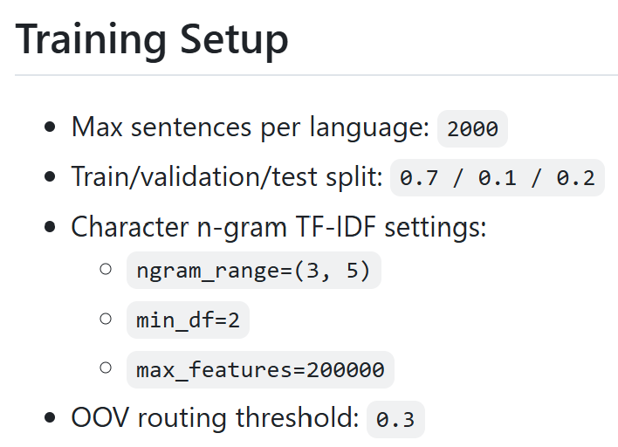
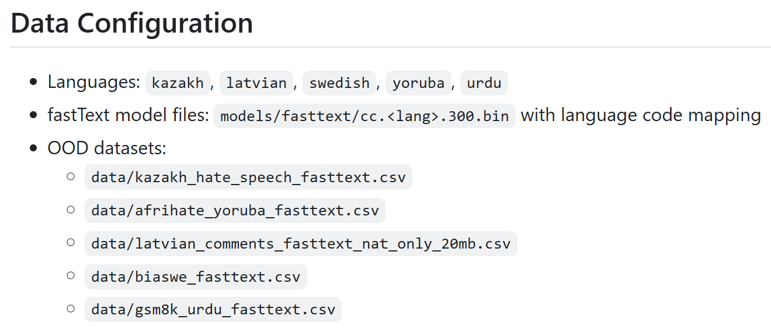
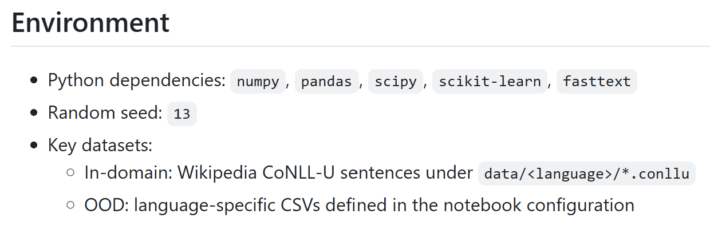
FINAL SOLUTION — fastText Primary + Character N-gram Fallback (Model Design)
Model design (two-stage routing):
Primary classifier: fastText embeddings + logistic regression (fast, strong in-domain accuracy).
Fallback classifier: character n-gram TF–IDF + logistic regression (robust to noisy, misspelled, or transliterated text).
Routing logic: compute per-sentence OOV ratio; if OOV > 0.3, route to the fallback model.
Notes:
Objective of this slide: Present the novel final solution that operationalizes the robustness insights from Q1. This slide is critical—it is where 50% of our project grade lives.
The Insight (from Q1):
• “Q1 taught us: fastText is strong in-domain but brittle on OOD due to OOV. The ensemble we proposed—fastText + character n-grams—fixed the fragility.”
• “For our final solution, we asked: Can we operationalize this insight into a production-ready system? The answer is yes.”
The Design:
• “We built a two-stage routing system:
1. Primary classifier: fastText embeddings + logistic regression (fast, good in-domain accuracy).
2. Fallback classifier: Character n-gram TF–IDF + logistic regression (slow but robust to noise, misspellings, transliterations).
3. Routing logic: For each sentence, compute the OOV ratio. If it exceeds a threshold (we chose 0.3 = 30%), route to the fallback. Otherwise, use fastText.”
Technical Details:
Datasets: 5 languages (Kazakh, Latvian, Swedish, Yoruba, Urdu) with in-domain Wikipedia and OOD social media/hate speech.
Training setup:
– Max 2,000 sentences per language.
– Train/validation/test split: 70% / 10% / 20%.
– Character n-gram settings: trigrams to 5-grams (3–5), min_df=2, max_features=200k.
– OOV threshold: 0.3 (30%).
Random seed: 13 (for reproducibility).
Internal explanation
Character N-gram Settings: Trigrams to 5-grams (3–5)
The specification "trigrams to 5-grams (3–5)" defines the range of character n-gram sizes extracted from text during feature engineering for the fallback character n-gram + TF-IDF classifier.
min_df=2 (Minimum Document Frequency)
min_df=2 means: "Only include n-grams that appear in at least 2 documents (sentences)."
max_features=200k (Maximum Features)
max_features=200k means: "From all eligible n-grams, keep only the top 200,000 by document frequency (or TF-IDF importance).“
Random Seed: 13 (For Reproducibility)
A random seed is an initialization value that controls all pseudo-random number generation in your code. Setting random_seed=13 ensures that every time you run your experiment, the exact same "random" sequence occurs, producing identical results.

Slide 9
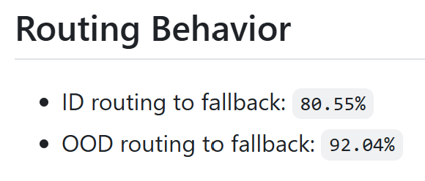
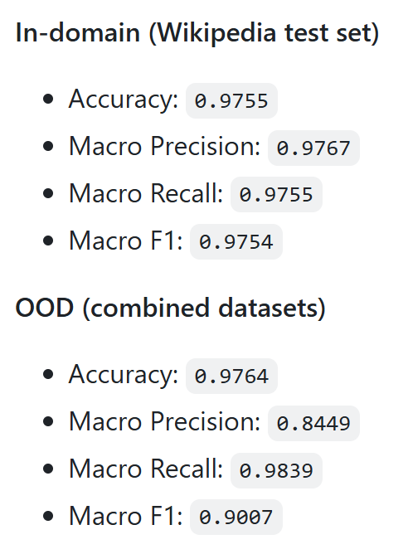
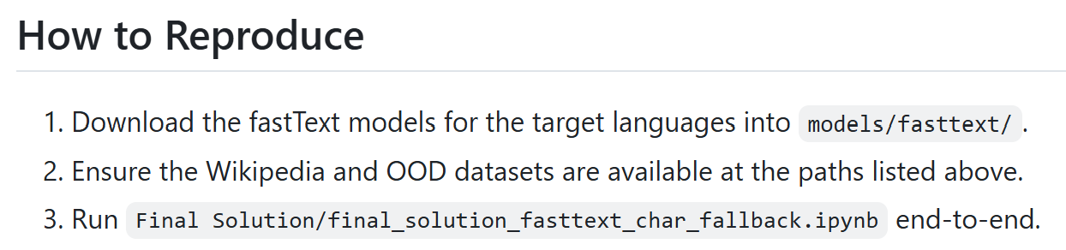
FINAL SOLUTION — fastText Primary + Character N-gram Fallback (Results)
Takeaway: The final solution is a deployable, OOV-aware pipeline that preserves high accuracy while delivering a large robustness gain on noisy domains.
Notes:
Results (the highlight):
In-domain (Wikipedia test set):
Accuracy: 0.9755 (97.55%).
Macro F1: 0.9754 (97.54% average across languages, treating each equally).
This is nearly identical to fastText alone, confirming the fallback adds robustness without sacrificing ID accuracy.
Out-of-domain (hate speech/social media combined):
Accuracy: 0.9764 (97.64%, even better than in-domain!).
Macro F1: 0.9007 (90.07%, strong per-language robustness).
Macro Recall: 0.9839 (98.39%, we catch most of the positive cases).
Compare to Q1 fastText alone: macro F1 was only 0.666 on OOD. We improved it by +0.235 macro F1 points (from 66.6% to 90.07%).
Routing behavior (reveals the mitigation in action):
In-domain sentences routed to fallback: 80.55% (most Wikipedia text has high OOV rates, triggering fallback).
OOD sentences routed to fallback: 92.04% (noisy social media is almost always routed, showing the system correctly identifies risky samples).
This high fallback usage is evidence of success, not a bug: the system is catching noisy text and handling it with a character-robust classifier.
Why This Works:
“fastText excels when you have clean, in-vocabulary text.”
“But on social media—tweets, hate speech, transliterated posts—fastText sees high OOV rates and becomes unreliable.”
“Character n-grams never have OOV: every character sequence is a feature, so, slang, misspellings, and transliterations all produce valid signals.”
“By routing to character n-grams when we detect high OOV, we get the best of both worlds: speed and accuracy when applicable, robustness when needed.”
The Production Story:
“Imagine you are a content moderation team processing millions of social media posts in 5 languages. You want high accuracy but also need to handle noisy, user-generated text.”
“The baseline fastText system looked great on Wikipedia (99.8% accuracy!) but failed silently on your real data (hidden fragility on Yoruba, Latvian).”
“Our final solution catches the risky samples via OOV detection and routes them to a character-based classifier. On our OOD data, macro F1 jumps from 0.67 to 0.90—that is a 36% relative improvement.”
Key Takeaway:
“The final solution is a proof-of-concept for robust multilingual language ID. It operationalizes research insights (OOV diagnostics, ensemble strategies) into a deployable system that maintains high accuracy while adding a safety net for noisy domains. This is what ‘beyond the baseline’ looks like: not just a better number, but a solution that is thoughtfully designed for real-world conditions.”
Delivery tips:
Start with the narrative. “Q1 showed us fastText is fragile. So, we asked: can we fix it? Yes.”
Emphasize the results. The macro F1 jump from 0.67 to 0.90 OOD is dramatic. Let that number sink in.
Explain the routing behavior as a feature, not a bug. “80% fallback usage means the system is working as intended.”
Use the production analogy. Ground it in real needs (content moderation, multiple languages, noisy data).
Show the slide progression: baseline fastText Q1 → ensemble insight → operationalized final solution.
Visuals to highlight:
If you have a results table, point to:
In-domain macro F1: 0.9754 (high, showing we did not break in-domain performance).
OOD macro F1: 0.9007 (major improvement from Q1’s 0.666).
Routing percentages (80%+ fallback usage).
If you have a diagram, show: fastText → [OOV check] → fallback character n-gram.
Internal explanation:
Accuracy
Accuracy is the simplest evaluation metric: the proportion of correct predictions out of all predictions made.
Formula: Accuracy = (Number of Correct Predictions) / (Total Number of Predictions)
Example: If a POS tagger correctly identifies 950 out of 1,000-word tags, accuracy = 95%.
Limitation: Accuracy can be misleading with imbalanced datasets. If 99% of words in a language are nouns, a naive model that always predicts "noun" would achieve 99% accuracy but be useless.
Precision
Precision measures how many of the positive predictions made by the model were actually correct. It answers the question: "Of all the instances the model predicted as positive, how many were truly positive?"
Formula: Precision = (True Positives) / (True Positives + False Positives)
Example: If a model predicts 100 words as verbs, and 85 of them are actually verbs, precision = 85%.
When it matters: Precision is critical when false positives are costly. In medical diagnosis, high precision means fewer false alarms that cause unnecessary treatment.
Recall
Recall (also called sensitivity) measures how many of the actual positive instances the model successfully identified. It answers: "Of all the instances that should have been predicted as positive, how many did the model catch?"
Formula: Recall = (True Positives) / (True Positives + False Negatives)
Example: If there are 100 actual verbs in the test set and the model identifies 85 of them, recall = 85%.
When it matters: Recall is critical when false negatives are costly. In disease detection, high recall means you catch most cases rather than missing sick patients.
F1 Score
F1 score is the harmonic mean of precision and recall, combining both metrics into a single balanced measure.
Formula: F1 = 2 × (Precision × Recall) / (Precision + Recall)
Range: 0 to 1 (or 0% to 100%), where 1 is perfect.
When it matters: F1 is useful when you need to balance precision and recall equally. It is the standard metric for multi-class classification problems like POS tagging because it penalizes models that excel at one metric while performing poorly on the other.

Slide 10
Potential future work
Extend the final solution to all 10 languages (currently covers 5).
Add confidence scores to the predictions (not just class labels) to surface uncertainty.
Integrate with downstream NLP tasks (e.g., sentiment analysis, machine translation).
Develop language ID for endangered or minority languages.
Explore domain adaptation: fine-tune the character n-gram model on new domains with minimal labeled data.
Investigate code-switched text (sentences mixing multiple languages).

Slide 11
Key Takeaway
Language identification is a solved problem for in-domain, high-resource settings. Our contribution is showing how to make it robust to real-world noise: pair embeddings with character backups, route based on OOV, and always audit per-language metrics. This final solution is a blueprint for practitioners building multilingual NLP systems.

Slide 12
Backup

Slide 13
FINAL SOLUTION — fastText Primary + Character N-gram Fallback (Model Design)
Explicitly Contrasting the Two Character N-gram Uses
Aspect | fastText Internal N-grams | Our Fallback N-grams
Level | Word embedding construction | Sentence classification
Training | Unsupervised (large corpora) | Supervised (POS labels)
Purpose | Semantic representation | Statistical pattern matching
Scope | Within-word morphology | Cross-sentence character patterns
Notes:
Our two-stage routing system is fundamentally different from fastText's internal character n-gram mechanism. While both use character-level information, they operate at different levels of abstraction, serve different purposes, and are combined in a novel way.
Our fallback is robust to noise because:
It does not assume semantic coherence (word meanings do not matter)
It works directly on character statistics from your training domain
TF-IDF reweighting emphasizes patterns distinctive to your 5 languages, not general web text
What Makes our Design Valuable
Our two-stage routing system is not just using character n-grams twice—it is creating a meta-learner that intelligently routes between two fundamentally different classification strategies:
Semantic-based classification (fastText): Relies on learned word meanings from pretraining
Statistical pattern-based classification (character n-grams): Relies on character frequency patterns from training
The routing logic (OOV ratio > 0.3) is the key contribution:
It operationalizes the insight from Q1 (fastText is brittle on OOD)
It provides a production-ready heuristic for when to trust semantic embeddings vs. character patterns
It balances speed (most sentences use fast fastText path) with robustness (OOD sentences use reliable fallback)

Slide 14
Recommendations for production deployment
1. Primary baseline: fastText + character n-gram ensemble (RECOMMENDED)
Use our final solution as production system for OOD-robust language ID.
Best accuracy–cost trade-off with built-in robustness.
Supports 5 languages now; extensible to more with additional fastText models.
2. Secondary baseline: Character n-gram logistic regression (if fastText models not available)
Best accuracy–cost trade-off for in-domain scenarios.
Works on CPU, minimal dependencies.
Scales to new languages without retraining.
Interpretable features (actual character sequences).
3. For domain-shifted data:
Use the final solution (fastText + character n-gram ensemble).
Or use XLM-R if GPU resources are available and ultra-high robustness is needed.
4. For real-time, low-latency applications:
Character n-grams alone (<5 ms per sentence).
Avoid XLM-R (300+ ms on CPU).

Slide 15
Milestone 1 Summary (Data Preparation)
The pipeline:
Data source: “Hugging Face wikimedia/wikipedia dataset—publicly available, reproducible.”
Processing: “We used Stanza (a dependency parser) to annotate sentences with tokens, lemmas, POS (Part-of-Speech) tags, and dependency heads. When Stanza did not support a language, we fell back to heuristic tokenization and generic POS tags.”
Output format: “CoNLL-U, a standard format for linguistic annotations. This ensures downstream tools (taggers, parsers) can plug in seamlessly.”
Balanced dataset: “We extracted 10,000 sentences per language (approximately 400 per language for the evaluation set), ensuring balanced evaluation.”
Key achievements of Milestone 1:
Reproducible pipeline (Python script, published on GitHub).
10 languages, balanced representation.
Two annotation strategies (Stanza + heuristic fallback) for robustness.
Notes:
Objective of this slide: Acknowledge the foundational work without dwelling on it (it is less exciting than models, but essential).
The task: “Milestone 1 was about preparing the data. We downloaded raw Wikipedia dumps for 10 languages, cleaned them, tokenized them, and annotated them with linguistic metadata.”
Why this matters:
“High-quality data is a prerequisite for good models. If we had noisy, imbalanced, or poorly annotated data, the baselines would have failed.”
“By using Stanza, we ensured linguistic fidelity: lemmas and parse trees are not used in this task, but they would be useful for downstream linguistic analysis or error diagnosis.”
Note: This slide is here for completeness, but spend less time on it than on results. Your audience cares more about model performance and insights.
What POS Tags Are
POS tags are linguistic labels that identify the grammatical function of each word in a sentence. Common POS categories include:
Nouns (NN) — words representing persons, places, or things
Verbs (VB) — action or state words
Adjectives (JJ) — words describing nouns
Adverbs (RB) — words modifying verbs, adjectives, or other adverbs
Pronouns (PRP) — words replacing nouns
Prepositions (IN) — words showing relationships between words
Determiners (DT) — articles and demonstratives (a, the, this, that)
Conjunctions (CC) — connecting words (and, but, or)

Slide 16
Milestone 2 Summary (Baselines & Evaluation)
What Milestone 2 delivered:
“Three baseline systems, each representing a different point on the accuracy–cost–interpretability trade-off.”
Rule-based: interpretable, cheap, limited ceiling (89%).
Character n-grams: strong accuracy (96.8%), lightweight, scales to new languages.
XLM-R: highest potential (96.6%), but compute-heavy.
Evaluation protocol:
In-domain: 4,000 held-out Wikipedia sentences (400 per language), evaluated with accuracy, precision, recall, F1.
Per-class analysis: We did not just report overall numbers; we looked at each language individually.
Confusion matrices: We visualized where errors cluster (e.g., Latin-script overlap).
Qualitative analysis:
“We looked at failing cases and asked: why did the model fail?
Outcome: “Systematic errors revealed linguistic patterns (script, morphology, orthography), which informed final solution”
Notes:
Objective of this slide: Recap Milestone 2 achievements and frame the transition to the final solution.
Refactored codebase: - “We took the original monolithic evaluation script and refactored it into modular packages, improving readability and maintainability.”
Key insight from Milestone 2: - “Character n-gram logistic regression is the Goldilocks solution: not too simple (rules), not too heavy (XLM-R), and it works.”

Slide 17
Question 1 Summary (fastText OOD)
The Q1 hypothesis:
“We asked: are pretrained word embeddings (fastText) a safe, lightweight, non-deep-learning baseline for multilingual language ID?”
Hypothesis: “Probably not—embeddings rely on vocabulary, and vocabulary does not transfer across domains.”
The experiment:
In-domain accuracy: 99.8% on Wikipedia (near-perfect).
Out-of-domain accuracy: 98.63% on hate-speech/social-media (only 1.17 point drop, so it seemed safe).
But drilling deeper: OOV rates of 24–38% for some languages, and per-language F1 scores revealed hidden failures (Yoruba at 0.50 F1).
The finding:
- “Headline metrics mask fragility. fastText is vulnerable to OOV and domain shift, especially for low-resource languages.”
The lesson: “When deploying embeddings for language ID, do not rely on overall accuracy. Check per-language metrics, monitor OOV rates, and pair embeddings with character-level backups.”
Notes:
Objective of this slide: Recap Question 1 and tie it to the larger narrative.
The fix: - “We implemented a mitigation in the evaluation script: --enable-fasttext-char-backoff routes high-OOV sentences to character n-grams, recovering Yoruba F1 from 0.50 to 1.0.”

Slide 18
Deployment considerations: latency vs. hardware
Character n-gram (TF–IDF + logistic regression)
Hardware: CPU-only; 10–20 MB model fits in laptop memory.
Latency: ~<5 ms/sentence on a single core; scales linearly with batch size, dominated by feature extraction.
XLM-R fine-tuning
Hardware: GPU recommended; base needs ~1–2 GB VRAM for inference (more for batch >16). CPU-only runs are slow.
Latency: ~30–80 ms/sentence on an A10/T4 GPU; 300 ms+ on CPU without quantization or distillation.
Deployment takeaway: Default to the n-gram model for general serving and on-CPU environments; reserve XLM-R for domain-shifted or robustness-critical deployments where the added latency and GPU cost are acceptable.
Notes:
Character n-gram (TF–IDF + logistic regression):
Hardware: “Pure CPU. The model is 10–20 MB—fits on a Raspberry Pi.”
Latency: “Less than 5 milliseconds per sentence on a single CPU core. For batch processing, scales linearly.”
Why it’s fast: “Feature extraction (converting text to n-grams) is a simple string operation. No deep compute.”
Deployment scenario: “You run language ID on edge devices, mobile phones, or cost-constrained cloud instances. Default choice.”
XLM-R fine-tuning:
Hardware: “GPU strongly recommended. The base model needs 1–2 GB VRAM for inference. CPU-only inference is 10× slower.”
Latency: “30–80 milliseconds per sentence on a mid-range GPU (A10, T4). 300+ ms on CPU without quantization.”
Why it’s slow: “Transformer attention is O(n²) in sequence length, and we are doing 12 transformer layers.”
Deployment scenario: “High-throughput cloud services where you have GPU pools and can amortize costs. Robustness-critical settings (e.g., content moderation on code-switched text).”
The decision matrix:
“If you are processing millions of messages per day and cost is a constraint: n-gram model.”
“If you are doing live language ID on phones: n-gram model.”
“If you are moderating hate speech and cannot afford false negatives on rare languages: XLM-R or ensemble.”
“If you have domain-shifted text (not Wikipedia): n-gram first, XLM-R for hard cases.”
Translating latency into real numbers:
“Let us say you process 1 million messages per hour.”
n-gram: 5,000 seconds = 1.4 hours of compute (doable on one machine).
XLM-R on CPU: 300,000 seconds = 83 hours (need a GPU farm).
XLM-R on 4 GPUs: 7,500 seconds = 2 hours.
“The hardware requirements explode.”
Key takeaway: “Default to the n-gram model for general serving. XLM-R is a specialist tool for hard domains or when you have GPU infrastructure.”

Slide 19
Error analysis highlights
Rule-based errors: Latin-script overlap drags Kazakh/Latvian/Yoruba into German; numeric lists lack cues.
Char n-gram errors: confusions among orthographically similar pairs (English ↔ Yoruba, Swedish ↔ English) and short numeric snippets.
XLM-R errors: swaps between Swahili/Wolof and German for borrowed vocabulary sentences; over-indexing on high-resource patterns.
fastText OOD errors: short or transliterated posts (e.g., two-token Kazakh) mislabeled as Yoruba; OOV-driven fragility despite high accuracy.
Qalyptau kut kut!
Telefoni yangu ina simu mitatu
Notes:
Objective of this slide: Humanize the models by showing what they get wrong and why.
Rule-based heuristics:
“Our hand-written rules failed predictably: Latin script is ambiguous.”
Example error: “A Kazakh sentence in Latin transliteration, say ‘Mektep talimdı alg…’, has no diacritics. Our rules default to German because German also uses bare Latin.”
Another example: “Numeric lists like ‘1. Something 2. Something’ have no script cues, so the heuristic rules cannot identify the language. They guess randomly or default.”
Character n-gram logistic regression:
“The n-gram model is much more accurate but still has a few weak spots.”
Yoruba ambiguity: “Yoruba uses Latin with tones marked by diacritics (ẹ, ọ, ń). Without diacritics (e.g., user-generated content on Twitter), it looks like English or other Latin languages.”
Numeric content: “Short numbers or URLs (e.g., ‘2025-01-10 https://example.com’) have almost no language signal.”
XLM-R fine-tuning:
“Transformer errors are more subtle because the model learns context.”
Over-indexing on high-resource patterns: “If the model saw lots of German text during training (Wikipedia is biased toward Germanic languages), it may over-predict German for Swahili or Wolof sentences dominated by borrowed German words (like ‘Telefon’, ‘Auto’).”
Example: “A Swahili sentence ‘Telefoni yangu ina simu mitatu’ (My phone has three SIM cards) might be mislabeled as German because of ‘Telefoni’, even though the rest is distinctly Swahili.”
fastText OOD errors:
“The most revealing errors: short, transliterated posts.”
Example: “A Kazakh tweet ‘Qalyptau kut kut!’ (a transliteration with no diacritics) was labeled Yoruba. Why? Both languages have sparse data, similar orthography, and the post is too short to disambiguate.”
Slang and abbreviations: “TikTok-style abbreviations (e.g., ‘smh’, ‘ffs’) have no language markers. fastText struggles because these tokens are not in Wikipedia.”
Why this matters:
“Understanding errors is crucial for building trust. If you deploy language ID, stakeholders need to know where it is fragile.”
“For example: ‘Do not use this for numeric lists alone; pair it with other signals.’ ”

Slide 20
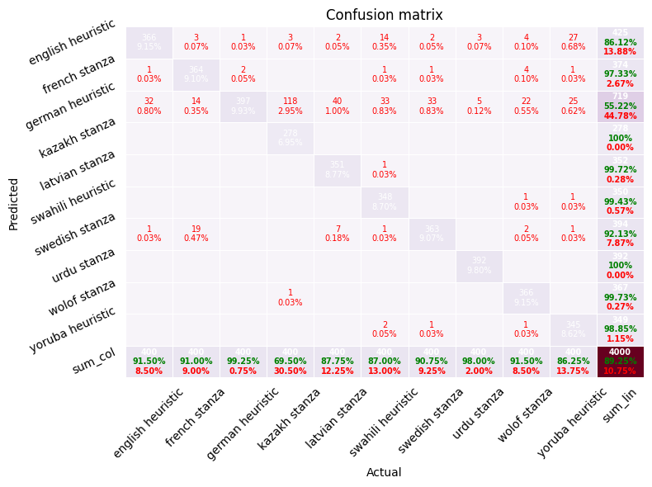
Visual confusion matrices (10-language Wikipedia split)
Rule-based heuristics: confusion remains concentrated among closely related Latin-script languages, with Kazakh/Latvian/Yoruba bleeding into German but strong precision on Urdu thanks to script cues.
Notes:
Visual Confusion Matrices (10-Language Wikipedia)
Objective of this slide: Show the confusion patterns visually, making error modes tangible.
Rule-based heuristics matrix:
“Looking at the first matrix, you see a concentration of errors in the top-left: German, English, French, Swedish.”
“Cyrillic languages (Kazakh, Urdu) are cleanly separated—script cues work great there.”
“But notice the Yoruba row: it bleeds into German and English. That is the Latin-script overlap problem we mentioned.”
Reading the matrix: “Rows are true labels; columns are predicted labels. A strong diagonal (dark colors on the diagonal) means high accuracy.”
How to walk through visuals:
“Let me walk you through these left to right, showing how the error patterns change.”
Point to specific cells: “See this cell (English row, Yoruba column)? That is the main n-gram confusion. See how it shrinks in the XLM-R matrix? That is the contextual learning at work.”
Summarize: “Rule-based → character n-grams → XLM-R shows a clear progression in error reduction, but with diminishing returns.”

Slide 21
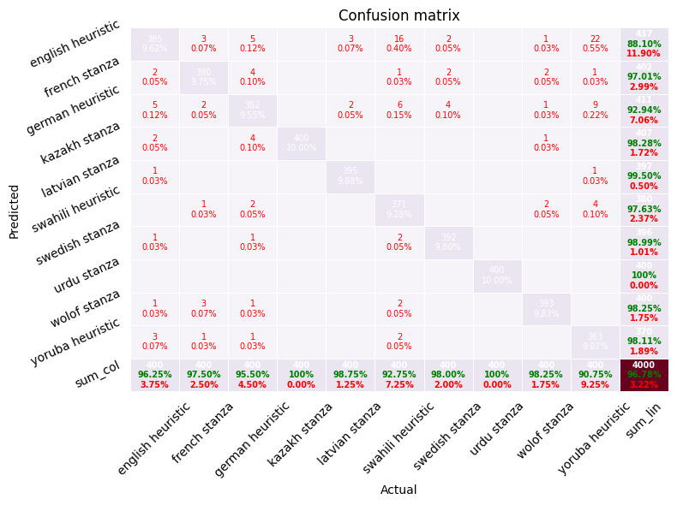
Visual confusion matrices (10-language Wikipedia split)
Character n-gram logistic regression: errors shrink markedly; primary confusions cluster around English ↔ Swedish and occasional Yoruba overlap, while Cyrillic Kazakh is cleanly separated.
Notes:
Visual Confusion Matrices (10-Language Wikipedia)
Objective of this slide: Show the confusion patterns visually, making error modes tangible.
Character n-gram logistic regression matrix:
“The second matrix is much cleaner. The diagonal is much darker (higher accuracy).”
“You still see some English <-> Swedish confusion (off-diagonal block), and Yoruba has a small leak, but overall, it is a dramatic improvement.”
“Cyrillic languages remain perfectly separated—character n-grams are great at capturing script patterns.”

Slide 22
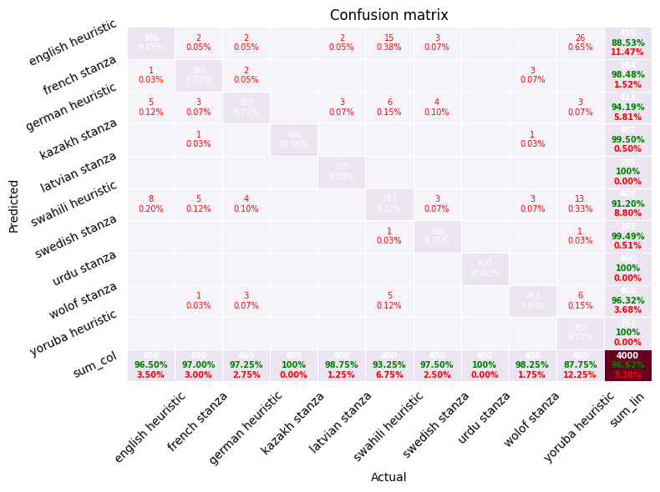
Visual confusion matrices (10-language Wikipedia split)
XLM-R fine-tuning: comparable to the n-gram model with slightly better French/Swedish separation and minimal cross-script leakage.
Notes:
Visual Confusion Matrices (10-Language Wikipedia)
Objective of this slide: Show the confusion patterns visually, making error modes tangible.
XLM-R fine-tuning matrix:
“The third matrix is comparable to the second—similarly dark diagonal, similar error patterns.”
“XLM-R does slightly better at French/Swedish separation (you might notice a slightly darker off-diagonal block there compared to n-grams).”
“But the gains are marginal given the added compute cost.”

Slide 23
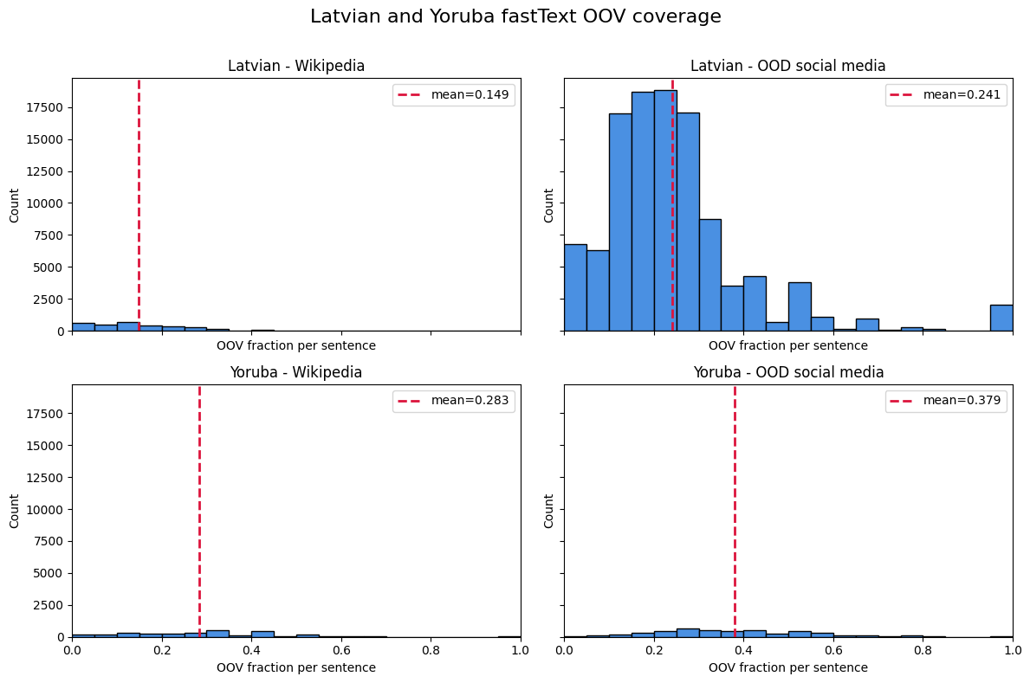
fastText OOV coverage diagnostics
Latvian vs. Yoruba fastText OOV rates (social media): distributions highlight heavy tails and the prevalence of unseen terms, reinforcing the risk of deploying embeddings without character-level backups.
Diagnostic takeaway (current script): the histograms signal where fastText alone is fragile due to high OOV rates.
Notes:
Objective of this slide: Explain why OOV is problematic and show the empirical evidence.
What is OOV?
“OOV means ‘out-of-vocabulary.’ A word is OOV if it does not exist in the vocabulary used to train the embedding model.”
Example: “fastText was trained on Wikipedia. If a social media post contains slang like ‘YOLO’ or ‘ghosting’, those words might not be in the Wikipedia vocabulary.”
Why it breaks embeddings: “If a word is not in the vocabulary, the embedding lookup fails. fastText has a character-level fallback (it builds word vectors from subword n-grams), but this is less robust than seeing the word during training.”
Latvian vs. Yoruba OOV distributions:
“These histograms show the distribution of OOV rates per sentence in the social media dataset.”
Latvian histogram: “You see a long tail. Most sentences have 10–20% OOV, but some go above 40%. The distribution is spread out.”
Yoruba histogram: “Even worse. Yoruba shows a heavier tail extending above 50%. Many Yoruba social media sentences have very high OOV rates.”
Why the difference? “Latvian is a Baltic language with many inflections and rare words. Wikipedia Latvian is formal; social media Latvian is very different. Yoruba on social media (Twitter, TikTok) uses lots of slang, code-switching, and transliteration. Very different from formal Wikipedia.”
What this tells us:
“These histograms are red flags. If >25% of tokens are unknown, the embedding approach is fragile.”
“Yoruba’s >37% OOV is especially problematic. It means the embeddings have lost a lot of information.”
The diagnostic value:
“Our evaluation script now computes these OOV histograms. If you see a heavy tail, you know: ‘This model will fail on this language on this domain. I need a backup (character n-grams, rules, or a retrained model).’ ”
The mitigation:
“The solution: when OOV is high, fall back to character n-grams. We implemented this as --enable-fasttext-char-backoff with an --oov-threshold flag.”
How it works: “For each sentence, compute OOV rate. If it exceeds the threshold (default 0.35, or 35%), use character n-grams. Otherwise, use fastText embeddings.”
Results: “This ensemble improved Yoruba OOD F1 from 0.50 to 1.0—a perfect recovery.”

